Slide 1
Physical Modeling: Aircraft Electrical System / Power Network
David Meissner, Application Engineer

Slide 2

Lunch & Learn: Modeling Aircraft Systems
Lockheed Martin Aeronautics ~ Palmdale, CA
June 17, 2015

Slide 3
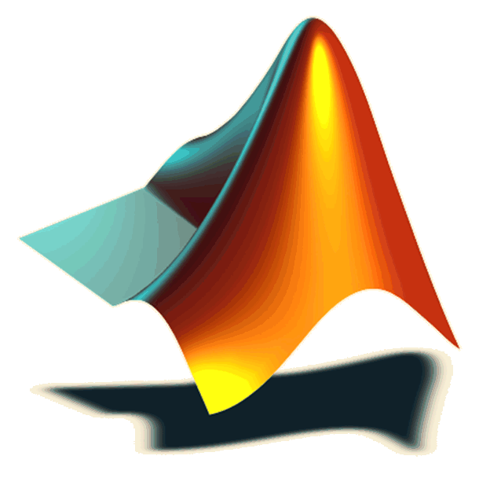
From MathWorks
Cole Stephens
Lockheed Martin Account Manager
Cole.Stephens@mathworks.com
508-647-1203
Richard Ruff
Application Engineer
David Meissner
Application Engineer
Chad Van Fleet
Pilot Engineer
Pascal Gahinet
MathWorks Development: Controls

Slide 4

Please note…
Today’s slides & demos will be available (Follow-up Email)
Feedback Forms…
Need Anything???
How can we help you???
Giveaways…
Dave did FANTASTIC!
1 2 3 4 5

Slide 5
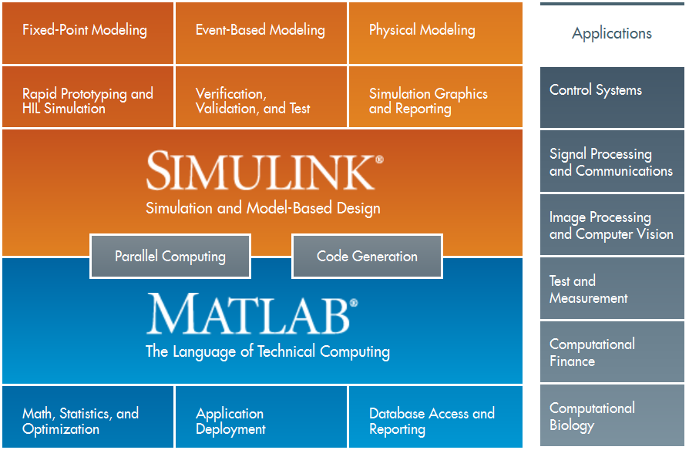
MathWorks Product Overview

Slide 6

Corp License 339958 – MATLAB Based Products

Slide 7
Corp License 339958 – Simulink Based Products
To see your license #, type “ver” in MATLAB

Slide 8
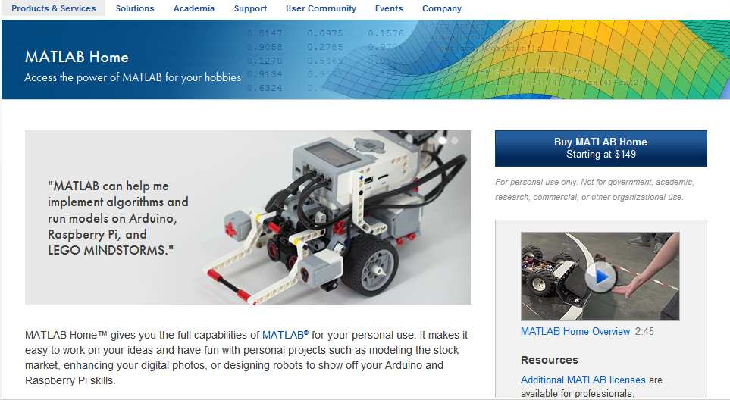
MATLAB – Home Use
www.mathworks.com/products/matlab-home/

Slide 9
Key Messages
Design and Analyze Electrical and Power Systems
Develop and Implement Logic and Controls
Perform Verification and Validation

Slide 10
Solar Impulse Develops Advanced
Solar-Powered Airplane
Challenge
Develop a solar-powered aircraft capable
of circumnavigating the globe
Solution
Use MATLAB and Simulink to create system models for trade studies and design tradeoff analysis, and aircraft dynamics models for high-fidelity simulations and pilot training
Results
Key design decisions made early
Vital pilot training enabled
Models reused and shared throughout development
The HB-SIA aircraft on a test flight over San Francisco Bay.
Photo © Solar Impulse | Revillard | Rezo.ch
“Simulations with MATLAB and Simulink were essential to assessing feasibility and evaluating broad design tradeoffs as well as making detailed design decisions—like the size of control surfaces and the vertical tail—that directly affect aircraft dynamics and handling qualities.”
Ralph Paul
Solar Impulse
Link to user story
Notes:
Industries: Aerospace and defense
Application Areas: Control systems
Capabilities: Data analysis, Mathematical modeling, Algorithm development, System design and simulation, Physical modeling
Products Used: MATLAB, Simulink, Control System Toolbox, Polyspace Bug Finder, Polyspace Code Prover
Country: Switzerland
Solar Impulse Develops Advanced Solar-Powered Airplane
Solar Impulse aims to promote the use of renewable energy by building an aircraft capable of circumnavigating the globe using only solar power. The Solar Impulse HB-SIA prototype took the first step toward that goal when it flew nonstop for more than 26 hours, powered only by solar energy and producing no polluting emissions. Lessons learned from the HB-SIA are being applied to the HB-SIB aircraft, which Solar Impulse plans to use for its round-the-world flight in 2015.
Solar Impulse engineers used MATLAB® and Simulink® to conduct advanced trade studies in which they evaluated design trade­offs and identified critical technology parameters. They used MATLAB and Simulink during the design and construction of the HB-SIA prototype to model and simulate aircraft.
“MATLAB and Simulink enable us to concentrate on high-level modeling and analysis instead of building up tool chains or writing low-level code,” says Ralph Paul, head of flight dynamics and flight test at Solar Impulse. “They give us the ability to prototype and iterate quickly, which is essential on first-of-its-kind projects like Solar Impulse.”
Challenge
When the Solar Impulse project began, no one knew whether a solar-powered aircraft capable of flying day and night could be built using available technologies. The first challenge was to analyze key factors, including solar cell efficiency, battery performance, wingspan, and weight, and perform tradeoff analysis to balance gathering solar energy and maintaining aerodynamic efficiency.
Initial trade studies focused on performance over a period of hours, but analysis on a much shorter timescale was needed to evaluate flight mechanics, aerodynamics, and flying qualities. Design and construction of the HB-SIA prototype depended on accurate simulations of the aircraft. So, too, did the Solar Impulse test pilots, who needed a flight simulator that replicated the handling qualities and flight dynamics of the Solar Impulse aircraft.
“Simulations with MATLAB and Simulink were essential to assessing feasibility and evaluating broad design tradeoffs as well as making detailed design decisions—like the size of control surfaces and the vertical tail—that directly affect aircraft dynamics and handling qualities.”
- Ralph Paul, Solar Impulse
Solution
Solar Impulse engineers used MATLAB and Simulink throughout the study, design, development, and mission planning stages of the HB-SIA prototype.
They used Simulink to create a system model of the aircraft, its structural properties, and its critical subsystems, including the lithium polymer batteries. Early simulations with this model indicated that the area needed for solar cells would require 80-meter wings; the team simulated and evaluated tradeoffs to identify optimal design parameters, enabling a 64-meter wingspan.
The engineers then modeled the aircraft dynamics in Simulink, including its aerodynamic properties, mechanical control systems, electric motors, propellers, and gearbox. Simulations helped the team validate and fine-tune the design.
To create a flight simulator for the HB-SIA, the team extended the aircraft dynamics model, adding S-functions to accept pilot controls and an X-Plane interface for visual feedback.
The team used MATLAB to develop algorithms for the onboard air data computer, which computes air speed and altitude based on pressure sensor data. MATLAB was also used to prototype algorithms for the Omega instrument, which reports the aircraft’s bank angle and flight direction accurate to one degree.
Using Control System Toolbox™ the team assessed autopilot system requirements and generated Bode plots to visualize system behavior.
After early test flights, the engineers analyzed flight data with MATLAB. They used the analysis results to refine the aircraft dynamics model, estimate sensor errors, and improve the air data computer algorithms.
Using Polyspace® code verifiers, the team analyzed the C implementation of air data algorithms and identified potential run-time errors and unsafe code.
Solar Impulse is using MATLAB and Simulink—and reusing modified HB-SIA models—in the development of the HB-SIB aircraft.
Results
■ Key design decisions made early. “The HB-SIA has dihedral wings, with the ends angled upwards,” says Paul. “Simulations in Simulink enabled us to rapidly and precisely determine the angle that would balance flying qualities, the requirements of the structural team, and solar efficiency.”
■ Vital pilot training enabled. “When the pilot turns the yoke to execute a turn, the aircraft’s nose initially moves up to 10 degrees in the opposite direction,” says Paul. “Our simulations predicted this, but more importantly, the flight simulator that we built with Simulink enabled our pilots to learn how to manage this counterintuitive behavior, especially for the final phase of the landing.”
■ Models reused and shared throughout development. “We reused our aircraft dynamics model for the flight simulator and the system model for flight planning,” says Paul. “Compared with low-level code, Simulink block diagrams make it easier to reuse and share designs and ideas across our team.”
Learn more about Solar Impulse: www.solarimpulse.com

Slide 11
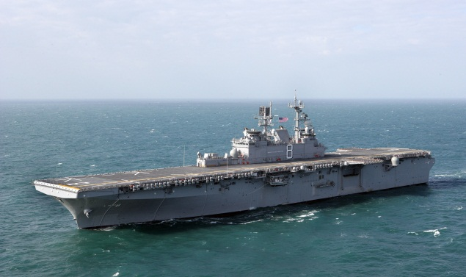
GasTOPS Develops and Tests Propulsion Control Algorithms for the USS Makin Island
Challenge
Develop the propulsion control algorithms for the USS Makin Island
Solution
Use Model-Based Design with MATLAB and Simulink to model the ship’s main systems, develop and verify control algorithms, and generate code for onboard training and HIL test setups
Results
Time-to-simulation cut by two-thirds
Key design issues identified early
Models reused multiple times
The USS Makin Island.
“We mitigate risk by simulating complex marine and aircraft systems before they are built. To reduce costs, we automate simulations with MATLAB and reuse models throughout development. Understanding
multidomain systems through simulations in Simulink and SimPowerSystems is invaluable to our business.”
Shaun Horning GasTOPS
Link to user story
Notes:
Industries: Aerospace and defense
Application Areas: Control systems
Capabilities: Data analysis, Mathematical modeling, Algorithm development, System design and simulation, Physical modeling, Embedded code generation
Products Used: MATLAB, Simulink, SimPowerSystems, Simulink Coder, Stateflow
Country: USA
GasTOPS Develops and Tests Propulsion Control Algorithms for the USS Makin Island
The USS Makin Island (LHD 8) is a twin-shaft amphibious assault ship in active service with the U.S. Navy. Nearly 850 feet long and with a full displacement of over 40,000 tons, the Makin Island can carry and launch dozens of helicopters and landing craft. Unlike earlier steam-powered ships of its class, the Makin Island uses a hybrid-electric propulsion system with gas turbines for high-speed travel and electric motors for efficient low-speed operation. The new propulsion configuration has two 35,000 BHP gas turbines, two 5000 BHP AC electric motors, and six diesel generators.
GasTOPS used Model-Based Design with MATLAB® and Simulink® to model the LHD 8 propulsion plant and develop its control algorithms, simulate the electrical power generation and distribution system, and create a simulator-stimulator system for real-time hardware-in-the-loop (HIL) testing of the machinery control system. This approach enabled the team to identify potential problems before sea trials began.
“With MATLAB and Simulink, we can rectify issues early in the design phase,” says Shaun Horning, vice president of Technical & Engineering Services at GasTOPS. “Before the ship is built, we can analyze crash astern, crash ahead, and other maneuvers, and generate a set of expected results to compare with actual sea trial results.”.
The Challenge
The machinery control system (MCS) aboard the LHD 8 controls the propulsion system, including transitions between electric motor and gas turbine drive modes, as well as more than 20 other major ship systems. Altogether, the MCS has more than 10,000 input and output signals.
To develop control algorithms for the complex, first-of-its-kind propulsion system, GasTOPS needed an accurate model of the plant. Later, GasTOPS would need to run parametric studies, model electrical power generation and distribution, generate code for HIL test setups, and create a simulation engine for an onboard training system. GasTOPS required a flexible, multidomain modeling and simulation environment that supported all these activities.
“We mitigate risk by simulating complex marine and aircraft systems before they are built. To reduce costs, we automate simulations with MATLAB and reuse models throughout development. Understanding multidomain systems through simulations in Simulink and SimPowerSystems is invaluable to our business.”
- Shaun Horning, GasTOPS
The Solution
GasTOPS used Model-Based Design with MATLAB and Simulink to accelerate LHD 8 development and analysis projects. GasTOPS engineers developed a Simulink model of the propulsion system, including submodels for the hull, propellers, shafting, gearboxes, motors, generators, and gas turbines.
Many of these submodels came from a Simulink library of parameterized components that GasTOPS had developed for similar projects. Others were provided by OEMs as MATLAB or Fortran code, and integrated into the Simulink propulsion model.
GasTOPS modeled the machinery control system in Simulink and Stateflow®, using state transition diagrams to describe drive mode changeovers.
The engineers conducted an extensive test program in which MATLAB scripts were used to launch Simulink and collect the results of simulated ship maneuvers under various environmental conditions. In parametric studies, sweeps of propeller efficiency, hull resistance, and other key values were conducted to assess MCS performance and robustness.
For the electrical plant, the team used Simulink and SimPowerSystems™ to model six diesel generators, eight transformers, numerous smart breakers, and the distribution system, as well as electric motors and other loads. They performed simulations to evaluate the system response to short circuits, generator failures, and various fault conditions.
GasTOPS combined elements of the propulsion and electric plant models with models of other machinery systems in Simulink, and used Simulink Coder™ to generate code for a real-time HIL testing setup. They streamlined this process by creating MATLAB functions that generate Simulink models based on predefined operating parameters for pumps, valves, fans, and other components.
Later, the team extended the MCS test model to support simulation of about 100 different system and component faults, and used Simulink Coder to generate C code for an onboard training system.
The MCS is now in service aboard the USS Makin Island.
Results
■ Time-to-simulation cut by two-thirds. “It’s not uncommon for companies to spend six months or more modeling ships and other complex systems before they get any useful simulation results,” says Horning. “Using MATLAB and Simulink with the library and scripts we have developed, we can have simulation results in two months or less, which can be a huge advantage during the design process.”
■ Key design issues identified early. “Our simulations revealed that in the transition from turbine power to electric power, the turbines provided substantially more power than was expected during their cool down,” explains Horning. “Simulink enabled us—and our clients—to understand how the systems would perform before the ship was built.”
■ Models reused multiple times. “Our propulsion and electrical system models were based on Simulink library elements,” says Horning. “We reused elements of those models extensively to verify the controller design, generate code for HIL tests, and create the core of the onboard training environment.”
Learn more about GasTOPS: www.gastops.com

Slide 12
NASA Interns Develop Guidance, Navigation, and Control Software for Quadcopter with Model-Based Design
Challenge
Give engineering interns hands-on work experience in the aerospace field
Solution
Create a program in which interns use Model-Based Design to model, simulate, implement, and fly GNC algorithms for multirotor aircraft
Results
GNC algorithms developed and implemented in 10 weeks
Hardware integration streamlined
Practical engineering experience acquired
NASA intern working with the quadcopter vehicle and ArduPilot Mega 2.5 hardware.
Model-Based Design makes both working engineers and interns at NASA MSFC more productive. The students have more fun because they can run the GNC algorithms they create in Simulink on a real processor and quickly get things done.
Link to user story
Notes:
Industries: Aerospace and defense
Application Areas: Control systems, Embedded systems
Capabilities: Data analysis, Mathematical modeling, Algorithm development, System design and simulation
Products Used: MATLAB, Simulink, Aerospace Blockset, Control System Toolbox, Embedded Coder
Country: United States
NASA Interns Develop Guidance, Navigation, and Control Software for Quadcopter with Model-Based Design
Internship programs at NASA provide engineering students with opportunities to work on engaging aerospace projects and introduce them to the tools and processes used by practicing engineers.
NASA’s Marshall Space Flight Center (MSFC) meets these objectives with a program in which interns and junior engineers use Model-Based Design with MATLAB® and Simulink® to develop guidance, navigation, and control (GNC) software for small multirotor aircraft.
With Model-Based Design, young engineers can build hardware, write flight software, and conduct flight tests to validate their models and control design in a 10-week program. They use the same tools the NASA MSFC team used to develop the GNC algorithms for the Mighty Eagle robotic lander and other systems.
Challenge
The NASA MSFC team sought a realistic yet economical way to give their interns opportunities to work directly with flight software and hardware. They selected a quadcopter vehicle and ArduPilot Mega 2.5 hardware for the program, but this approach brought several challenges.
First, they needed to provide undergraduate engineers, many of whom had little control design or programming experience, with easy-to-learn tools that they could use to rapidly develop GNC algorithms. Second, to avoid damaging the aircraft, they needed a simulation environment that would enable the interns to verify their algorithms before flight testing. Lastly, they needed an easy way for the interns to deploy algorithms to the ArduPilot hardware and interact with the accelerometers, gyroscopes, and other sensors on the ArduPilot board.
Model-Based Design makes both working engineers and interns at NASA MSFC more productive. The students have more fun because they can run the GNC algorithms they create in Simulink on a real processor and quickly get things done.
Solution
The NASA MSFC team selected Model-Based Design with MATLAB and Simulink for their engineering internship program.
Interns learn modeling, simulation, and control design in Simulink by viewing the Simulink tutorials on mathworks.com and attending training sessions conducted by NASA engineers.
After assembling the quadcopter from a kit, they build a six-degree-of-freedom model of the quadcopter in Simulink, using Aerospace Blockset™ to model the equations of motion.
Working in Simulink, they create a controller model to provide stability augmentation for the quadcopter. To access input from ArduPilot sensors, including accelerometers, gyros, and the magnetometer, they add blocks from the APM2 Simulink Blockset to their controller model.
They acquire a linear model from Simulink, analyze the gain and phase margin with the SISO Design Tool from Control System Toolbox™, and then run simulations to verify the control system performance. Using a block from Aerospace Blockset, they connect the model to FlightGear flight simulation software to visualize simulation results, and then refine their design based on those results.
Using the Run on Target Hardware feature of Simulink, the interns load their controller model directly onto the ArduPilot Mega hardware for flight testing.
They postprocess recorded flight data in MATLAB and use the results to fine-tune their control algorithms and plant model.
NASA MSFC engineers are currently revising their internship program. The new version will use a hexacopter. The ArduPilot Mega hardware will be replaced with the more powerful Pixhawk processor, which will enable interns to incorporate Kalman filtering, implement sliding mode controls, and handle engine out conditions. They will generate C code for the Pixhawk target from their Simulink models using Embedded Coder®.
Results
■ GNC algorithms developed and implemented in 10 weeks. For working aerospace engineers, it can be a daunting task to develop a high-level control algorithm, write it in C, and integrate it with other code needed to fly the aircraft. With Model-Based Design, NASA interns develop their control algorithms and have them flying in 10 weeks.
■ Hardware integration streamlined. With a single click, the interns deployed their Simulink model to the Arduino and were ready to test their algorithms in flight. Using the APM2 Simulink Blockset simplified communication with ArduPilot hardware.
■ Practical engineering experience acquired. One of the interns used the knowledge he gained at NASA to design an advanced Kalman filter for flight control on his fourth-year engineering design project. Another was offered a job simulating quadcopters, in part because of his Model-Based Design experience.
Learn more about NASA Marshall Space Flight Center: http://www.nasa.gov/centers/marshall/home/

Slide 13
Aircraft Power Network
Half-aircraft model
One generator
AC bus with loads
TRU (Transformer- Rectifier Unit)
DC bus with loads and battery
Breakers open and close during flight cycle
DC Bus
Batt
TRU
AC Bus
GEN
DC1
AC1
APU
DC2
AC2
GEN
DC3
AC3
External Power
Not modeled
Breaker

Slide 15
What is the Most Expensive Project Stage to Find Errors In?
Relative cost to fix an error
Errors introduced in:
coding phase
design phase
requirements phase
Requirements phase
Design phase
Coding phase
Testing phase
Project phase where error is fixed
Source: Return on Investment for Independent Verification & Validation, NASA, 2004.
Notes:
So why do we need to find errors early, why did people list it as an important challenge?
Here is a study by NASA, that answers these questions. The x-axis shows the phase where the error is found and fixed, and the y-axis shows the relative cost to fix the error.
Bar color corresponds to the project phase where the error was introduced.
[Advance]
For example the most expensive type of error to fix is an error in the requirements that is only found during testing.
It is very expensive because you will need to go through the whole development process to fix it – not only expensive, but also time-consuming.
So, finding errors early means we can develop our products cheaper and quicker, and that is why it is so important.
[Note to presenter: NASA study can be downloaded directly from http://sarpresults.ivv.nasa.gov/DownloadFile/24/10/Direct%20ROI%20of%20IV&V%20ATS2003%20presentation.ppt
The saved version of the report (powerpoint file) is also available on the ECL).]

Slide 16
System Engineering Return On Investment
SE-ROI is discovered to be
as high as 7:1 for programs with little SE effort and
3.5:1 for median programs.
Optimum SE effort for median programs:
14.4% of total program cost.
To map ROI potential to MBD, it is helpful to break down SE activities that can be evidenced across the following standards:
ANSI/EIA-632, IEEE-1220, ISO-15288, CMMi, and MIL-STD-499.

Slide 17

Traditional Development Process
RESEARCH
REQUIREMENTS
SPECIFICATIONS
Requirement Documents
Difficult to analyze
Difficult to manage as they change
Paper Specifications
Easy to misinterpret
Difficult to integrate with design
DESIGN
EDA
Algorithm
Design
MCAD/
MCAE
Physical Prototypes
Incomplete and expensive
Prevents rapid iteration
No system-level testing
Electrical Components
Embeddable Algorithms
Mechanical Components
Manual Coding
Time consuming
Introduces defects and variance
Difficult to reuse
IMPLEMENTATION
C/C++
Traditional Testing
Design and integration issues found late
Difficult to feed insights back into design process
Traceability
Embedded Software
INTEGRATION AND TEST
Notes:
Let’s look at a simplified representation of a traditional development to understand why it is difficult to find errors early in designing multi-domain systems.
[ Short Version ]
[Advance]
The complexity in systems is dictating more complex requirements. These more complex requirements are difficult to analyze and to manage as they change.
[Advance]
Complexity of specifications makes them easy to misinterpret. It is also difficult to trace specs to the design.
[Advance]
The controller algorithms are manually tuned on a prototype or on the actual system. Prototypes often are not easily available or let you test only part of the overall system.
[Advance]
Coding is done manually, often resulting in errors when design is not interpreted correctly.
[Advance]
And the integration and test phase is where the problems show up, since that is the first time systems are integrated. The result is that errors are found late and are expensive to fix.
[Advance]
The different tools used throughout the development process make it difficult to understand how the whole system will work and how different components will interact with each other.
If different groups are working on different parts of the projects, there is also a communication problem between them.
[Advance]
So let me introduce Model-Based Design and explain how it will help you detect errors early and therefore allow you to design innovative products with high performance faster and cheaper.
Model-Based Design is a Computer Aided Engineering (CAE) solution for MATHEMATICALLY describing how the equipment will work.
[Advance]
[Long Version]
Generally, a typical process for a project to design an embedded control system involves iterative cycles of these phases:
Specification development
Design and Implementation
Integrate and Test
[Advance]
This design approach starts with requirements and specifications which are typically text documents. With any document, interpretation is subjective to the reader, so misinterpretation of the design intent is common. In addition, engineers involved might not realize that the document is missing crucial information until the project reaches a later stage when hardware becomes available.
[Advance]
In the design and implementation stage, components for each subsystem (for example: mechanical electrical, controls, embedded software) are designed in different tools that do not necessarily facilitate system level analysis of how the different components will interact with each other, and how the product will work in the operating environment.
[Advance]
Testing occurs only when each component has been implemented and then integrated into a prototype. Prototypes are expensive and time-consuming to create – you can only make a limited number of prototypes and most likely you will take the path that ensures early success; typically a modest variation of previous products. To be clear, physical prototyping is ALWAYS required, however, physical prototyping limits the number of potential designs you will consider. You may pass over the truly innovative approach because of the perceived risk. With a physical prototype, you attempt to meet all of your design specification requirements, but you will not know until you begin testing it.
[Advance]
So integrating and testing the design only with prototypes means both integration errors and some component errors are only found at this late stage of the development process. Then the time-consuming and costly activity of isolating the source of the error and then fixing it needs to occur. In the worst case you discover the requirements were wrong when the product is already deployed in the field. In this case you need to go through the whole design process, costing you not only time, money but your reputation with your best customers.
[Advance]
The different tools used throughout the development process make it difficult to understand how the whole system will work and how different components will interact with each other.
[Advance]
So as you see with this process you find errors late, and that leads to less performance, more cost, and longer time to bring the product to market – exactly the opposite of what we need to do to be successful, as we discussed in the previous slides.
So let me introduce Model-Based Design and explain how it will help you detect errors early and therefore allow you to design innovative products with high performance faster and cheaper.
Model-Based Design is a Computer Aided Engineering (CAE) solution for MATHEMATICALLY describing how the equipment will work.
[Advance]
(use as needed)
Some other drawbacks of this approach include:
Changing design specifications – At some point, requirements may evolve. Understanding the impact to the project is difficult. Will the design still work as you originally intended? Will you need to develop different physical prototypes?
Writing code for the embedded system. If the specification document is incomplete or subject to interpretation, errors will likely show up in code. At this point, backtracking these problems will take considerable time and will likely involve some rework of earlier phases. In addition, hand coding is subject to errors.

Slide 18
Systems Engineering Categories
Mission / Purpose Definition (MD)
Requirements Engineering (RE)
System Architecting (SA)
System Integration (SI)
Verification and Validation (VV)
Technical Analysis (TA)
Scope Management (SM)
Technical Leadership / Management (TM)

Slide 19
Model-Based Design
RESEARCH
REQUIREMENTS
DESIGN
Environment Models
Physical Components
Algorithms
TEST AND VERIFICATION
IMPLEMENTATION
C, C++
VHDL, Verilog
Structured Text
MCU
DSP
FPGA
ASIC
PLC
INTEGRATION

Slide 20
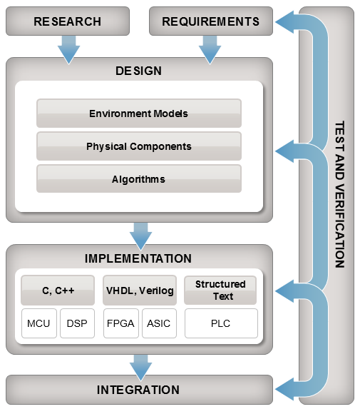
Systems Engineering and MBD
Mission
/ Purpose Definition
Requirements Engineering
System Architecting
System Integration
Verification and Validation
Technical Analysis
Scope Management
Technical Leadership
/ Management

Slide 21
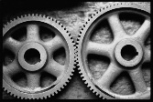
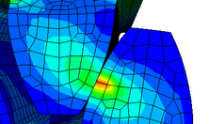
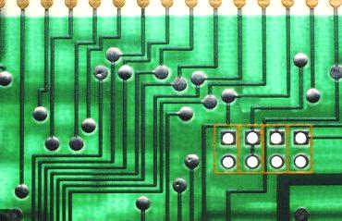
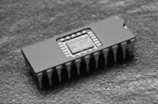
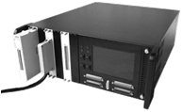
Model-Based Design System and Component Level Design
REQUIREMENTS
System-level simulation refines requirements for component design
DESIGN
SYSTEM LEVEL DESIGN
COMPONENT DESIGN
Control
Mechanical
Electrical
JMAG
SABER
SPICE
TEST & VERIFICATION
Co-simulation can be used as a verification step
IMPLEMENTATION
Embedded Software
HIL System
Results from detailed simulation refine system-level simulation for use in rest of design process
INTEGRATION AND TEST
Notes:
Blue arrow from “Component Design” to “System Level Design” includes:
Parameter estimation based on simulation results
Mode export from FEA
Reduced order modeling

Slide 23
Aircraft Power Network
Half-aircraft model
One generator
AC bus with loads
TRU (Transformer- Rectifier Unit)
DC bus with loads and battery
Breakers open and close during flight cycle
DC Bus
Batt
TRU
AC Bus
GEN
DC1
AC1
APU
DC2
AC2
GEN
DC3
AC3
External Power
Not modeled
Breaker

Slide 24
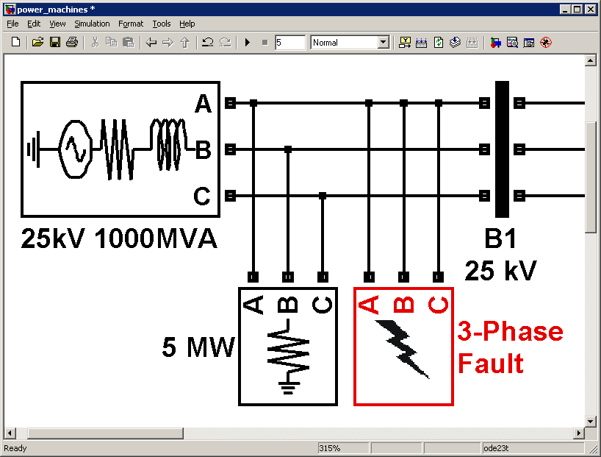
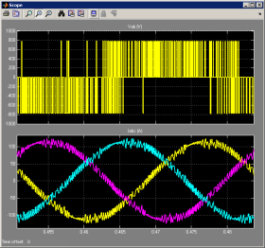
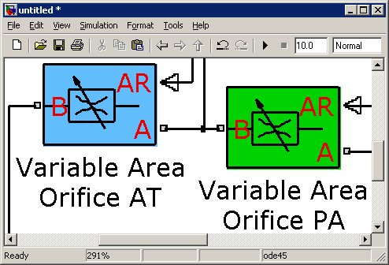
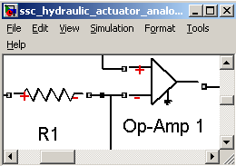
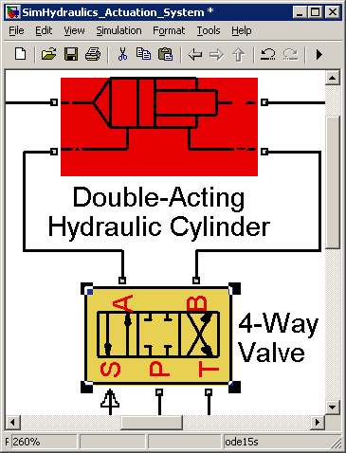
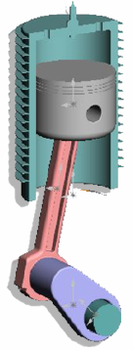
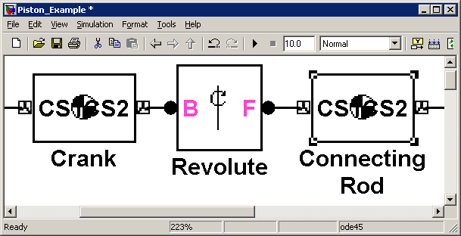
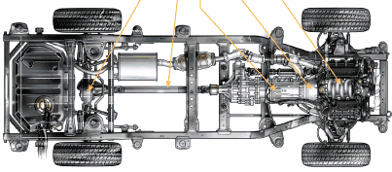
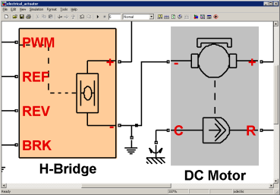
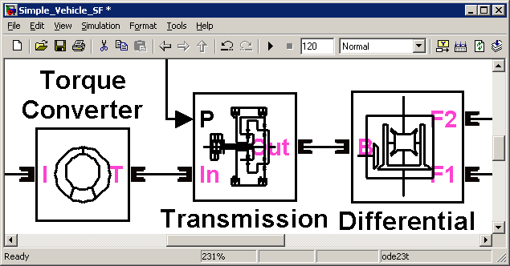
Physical Modeling
SimPowerSystems™
SimHydraulics®
Simscape™
Multi-domain physical systems
SimMechanics™
SimDriveline™
SimElectronics™
Electrical power systems
Fluid power and control
Mechanical dynamics (3-D)
Drivetrain systems (1-D)
Electromechanical and electronic systems

Slide 25
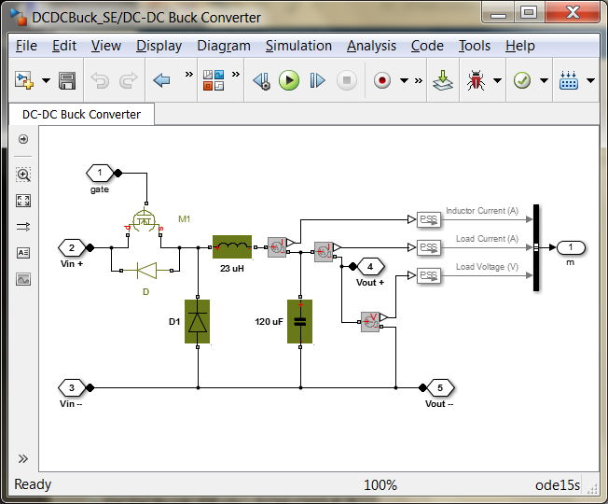
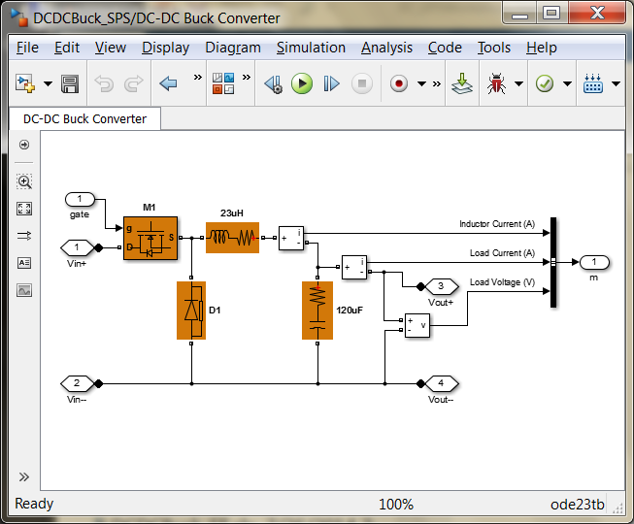
Modeling Electronics and Power Systems
SimPowerSystems
Piecewise linear systems solution
Multiphase bridges and pulse generators
Detailed and average voltage models
Transient and harmonic analysis
Faster simulation
SimElectronics
Simultaneous nonlinear equations solution
SPICE level switching device models
Include switching losses
Include parasitic current effects
Include temperature effects
Higher fidelity simulation
>> se_dcdcbuckconverter
>> sps_dcdcbuckconverter

Slide 26
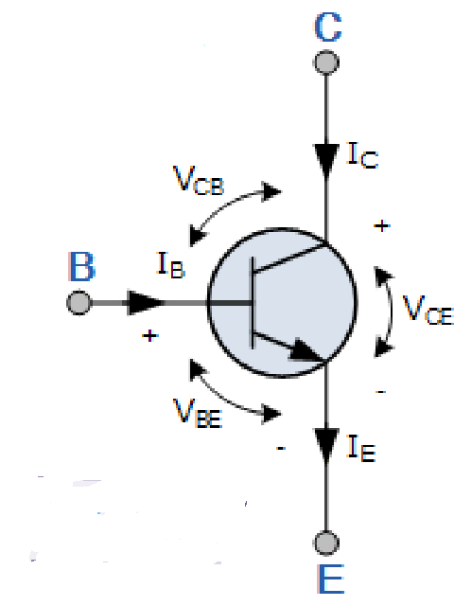
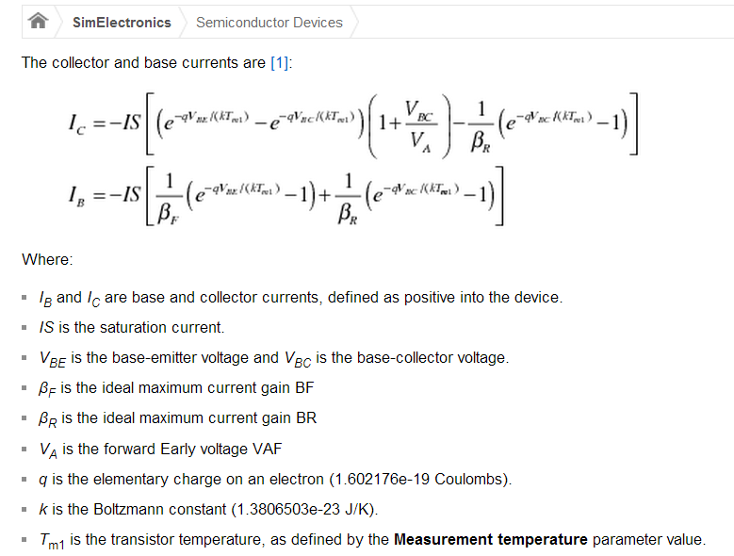
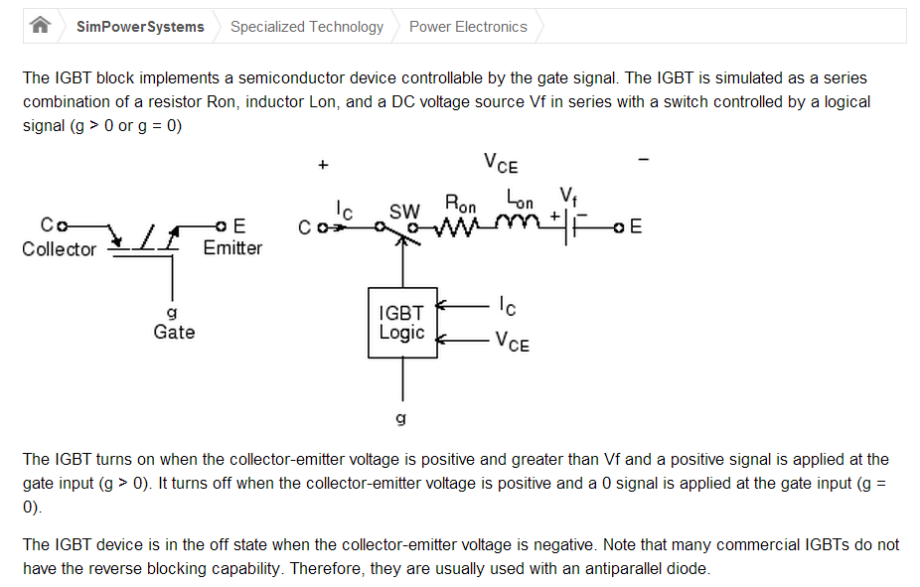

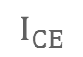
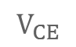
SimElectronics or SimPowerSystems?
SimElectronics
SimPowerSystems
$$V_{BE}$$
$$I_{CE}$$
$$V_{CE}$$

Slide 27
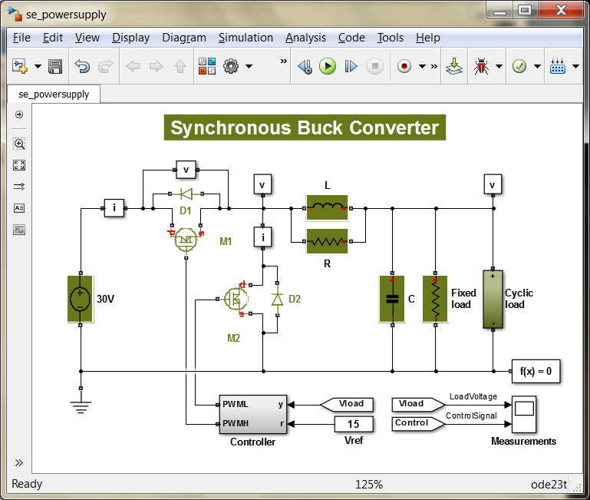
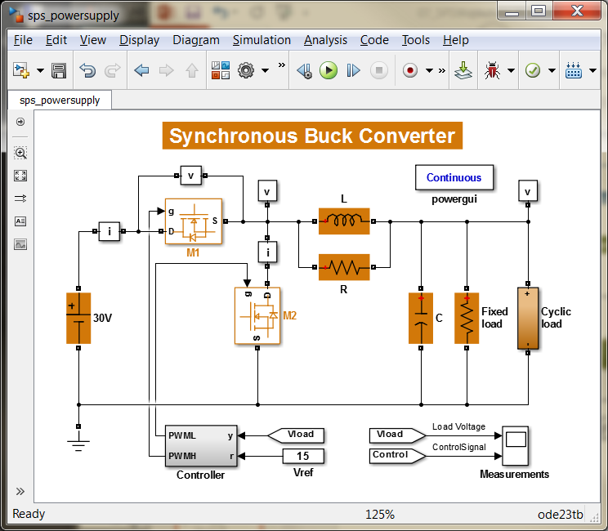
SimElectronics or SimPowerSystems?
SimElectronics
SimPowerSystems
>> edit compare_powersupply

Slide 28
Logic and Controls
Implement and Debug Logic Graphically
Develop and Test Controls
Code Generation
Examples:
Synchronizing Breaker
Voltage Regulator

Slide 29
Verification and Validation
Requirements Traceability
Design Validation and Analysis
Test and Verification
Examples:
Aircraft Power Network
Managing Requirements for Fault-Tolerant Fuel Control System
Code Generation Verification Workflow with Simulink Test

Slide 30
Verification and Validation
Model and Code Coverage
Design Error and Bug Detection
Certification, Standards and Code Proving
Examples:
Top-Level Model Coverage Report
Find Defects from the Polyspace Environment
Workflow for Tool Qualification

Slide 31
Summary
Design and Analyze Electrical and Power Systems
Develop and Implement Logic and Controls
Perform Verification and Validation

Slide 32


Additional Resources
Videos and Webinars
Aircraft Power Network (4:58)
Automatic Report Generation for Aircraft Power Network (2:30)
Running Parallel Simulations of Aircraft Flight Cycles (5:00)
Aircraft Power Network Development with MBD (46:41)
Example: Aircraft Power Network on MATLAB Central
Documentation: (SimElectronics) (SimPowerSystems)
Tutorials: Build and Simulate a Simple Circuit
Training: Physical Modeling: Electrical Power Systems
Consulting: Proven Solutions from MathWorks Consulting

Slide 33
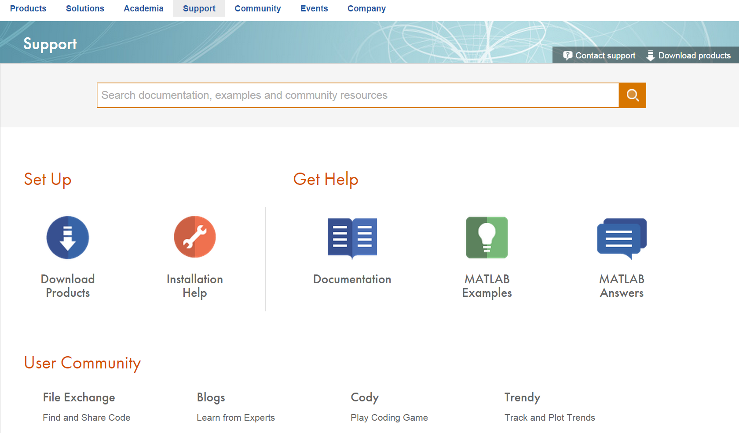
Support

Slide 34
Thank You for Attending Today!
Point of Contact
Cole Stephens, Lockheed Martin Account Manager
Cole.Stephens@mathworks.com
508-647-1203
Products, Webinars, Events, Training:
www.mathworks.com
On-Demand, Recorded Webinars
http://www.mathworks.com/company/events/webinars/index.html
On-Demand Training (self-paced, online)
MATLAB Academy (complimentary)
MATLAB Fundamentals
MATLAB Programming Techniques
MATLAB for Data Processing and Visualization
Remember: Turn in your feedback form & pick up a give-away

Slide 35

Contact Us
MathWorks:
Monday - Friday
08:30-17:30 ET
08:30-20:00 ET
(508) 647-7000
Sales / Customer Support ......
Technical Support ......

Slide 36
Backup

Slide 37
MathWorks Product Overview

